Slide 1



September 2022
CORPORATE PRESENTATION
NASDAQ: INDP

Slide 2
FORWARD LOOKING STATEMENTS
This presentation contains forward‐looking statements with the meaning of the Private Securities Litigation Reform Act. These include statements regarding management’s expectations, beliefs and intentions regarding, among other things, our product development efforts, business, financial condition, results of operations, strategies, plans and prospects. Forward‐looking statements can be identified by the use of forward‐looking words such as “believe”, “expect”, “intend”, “plan“, “may“, “should“, “could“, “might“, “seek“, “target“, “will”, “project“, “forecast“, “continue” or “anticipate” or their negatives or variations of these words or other comparable words or by the fact that these statements do not relate strictly to historical matters. For example, forward‐looking statements are used in this presentation when we discuss Indaptus’s future plans and expected timeline of its development pipeline.
Forward‐looking statements relate to anticipated or expected events, activities, trends or results as of the date they are made. Because forward‐looking statements relate to matters that have not yet occurred, these statements are inherently subject to risks and uncertainties that could cause our actual results to differ materially from any future results expressed or implied by the forward-looking statements. In addition, historical results or conclusions from scientific research and clinical studies do not guarantee that future results would suggest similar conclusions or that historical results referred to herein would be interpreted similarly in light of additional research or otherwise. Many factors could cause actual activities or results to differ materially from the activities and results anticipated in forward‐looking statements, including, but not limited to, the following: Indaptus's plans to develop and potentially commercialize its technology; the timing and cost of Indaptus's planned investigational new drug application and any clinical trials; the completion and receiving favorable results in any clinical trials; Indaptus's ability to obtain and maintain regulatory approval of any product candidate; Indaptus's ability to protect and maintain its intellectual property and licensing arrangements; Indaptus's ability to develop, manufacture and commercialize its product candidates; the risk of product liability claims; the availability of reimbursement; the influence of extensive and costly government regulation; and Indaptus's estimates regarding future revenue, expenses, capital requirements and the need for additional financing following the merger. These risks, as well as other risks are discussed in the proxy statement/prospectus that was included in the registration statement on Form S-4 filed with the SEC in connection with the merger.
All forward‐looking statements speak only as of the date of this presentation and are expressly qualified in their entirety by the cautionary statements included in this presentation. Indaptus does not undertake any obligation to update or revise forward‐looking statements to reflect events or circumstances that arise after the date made or to reflect the occurrence of unanticipated events, except as required by applicable law.
The presentation contains information about investigation‐stage drug products under development, which have not yet been approved by the FDA for commercial distribution in the United States. All representations in this presentation are based upon investigations in certain clinical and other research, but which accordingly should not be construed as general claims for the safety or efficacy of the products when used by patients.
The presentation is not intended and does not constitute an offer to sell or the solicitation of an offer to buy any securities, nor shall there be any sale of securities in any jurisdiction in which such offer, solicitation or sale would be unlawful prior to the registration or qualification under the securities laws of any jurisdiction. No offering of securities shall be made except by means of a prospectus meeting the requirements of Section 10 of the Securities Act of 1933, as amended.

Slide 3
INVESTOR HIGHLIGHTS AND KEY METRICS
Clinical-stage asset preparing to enroll
Phase 1 clinical trial in solid tumors
Innovative and flexible clinical platform based upon application of proven scientific principals
Flexible application of technology that has applications across oncology, infectious diseases and other areas of immunology
Potential to utilize compounds as single-agent treatment and combination therapy
Excellent pre-clinical safety profile
Favorable cash position into Phase 1 trials
Experienced leadership having led multiple research/clinical programs & FDA approvals
STOCK SYMBOL: INDP (NASDAQ CM)
Stock Price (9/7/22) | $2.50
52 Week Range | $1.89 - $7.63
Average Daily Volume | 34.5K
Common Shares Outstanding (5/13/22) | 8.26M
Market Capitalization (7/08/22) | $22.4M
Cash & Equivalents (6/30/22) | $33.0M
Insider Ownership (%) | 38.56%

Slide 4
SUMMARY OF INDAPTUS TECHNOLOGY
Decoy therapeutics exhibit many unique properties
Single agent anti-tumor activity
Tumor eradicating synergy with several different existing therapies
Reduced toxicity and broad therapeutic index
Safe induction of both innate and adaptive immune pathways
Innate and adaptive immunological memory leading to rejection of tumor re-challenge
No induction of cytokine release syndrome in IND-enabling toxicology
Significant single agent activity in pre-clinical models of HBV and HIV

Slide 5






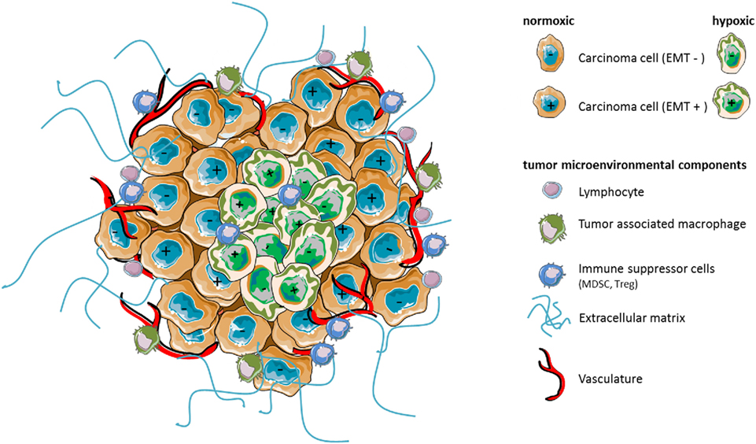

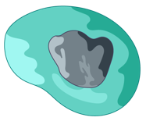
CURRENT CANCER IMMUNOTHERAPIES ONLY ADDRESS A
LIMITED PART OF THE IMMUNE SYSTEM AND THEREFORE HAVE
LOW CURE RATES IN ADVANCED CANCERS
Targeted Antibodies
IL-2 and IFN-α
T-vec/GM-CSF
Checkpoint
CAR-T
Gamma-Delta
T-Cell
TAA
Natural Killer
T-Cell
Natural Killer Cell
Dendritic Cell
INNATE
ADAPTIVE
Neutrophil
CD8+ T-Cell
TAA
Macrophage
CD4+ T-Cell
TUMOR

Slide 6

NO ONE HAS FIGURED OUT HOW TO DO THIS SAFELY…
BUT HISTORY HAS PROVIDED A CLUE
DECOY
Targeted Antibodies
IL-2 and IFN-α
T-vec/GM-CSF
Checkpoint
CAR-T
Gamma-Delta
T-Cell
TAA
Natural Killer
T-Cell
Natural Killer Cell
Dendritic Cell
INNATE
ADAPTIVE
Neutrophil
CD8+ T-Cell
TAA
Macrophage
CD4+ T-Cell
TUMOR

Slide 7
WORLD’S FIRST IMMUNOTHERAPY:
COLEY’S TOXINS (CT)
Based on long-standing observation of spontaneous cancer regression in the setting of infection
Composed of a heat-killed mixture of Gram-negative/positive pathogenic bacteria
Coley’s Toxins produced durable responses with advanced cancer patients
Mechanism of action was not known – impossible to optimize or standardize, multiple formulations
Chemotherapy and radiation therapy supplanted CT approach by mid-20th century
We now know that activation of the immune system by microbial “danger signals” can lead to durable anti-tumor responses
The most prominent danger signal family activates Toll-like receptors (TLR) on Immune Cells
TLRs directly and indirectly activate essentially all immune cells (innate + adaptive) and are critical for anti-tumor and anti-viral immune responses

Slide 8
CHALLENGE – IV ADMINISTERED OF GRAM-NEGATIVE BACTERIA ARE TOXIC
Analyzing this approach with today’s information:
TLR4 agonist LPS-endotoxin constitutes ~75% of the Gram-negative outer cell membrane
LPS has been shown to be one of the most potent and broadly acting innate and adaptive immune system-activating danger signals, but produces toxicity when too much LPS is administered i.v.
This probably limits the number of other immune-stimulating danger signals that can be safely administered i.v. with LPS
Indaptus Approach SIGNIFICANTLY REDUCES LPS, but leaves enough to activate innate & adaptive
immune responses

Slide 9
PRODUCING A MULTI-TARGETED PACKAGE OF IMMUNE SYSTEM ACTIVATING SIGNALS – A RE-INVENTING OF THE APPROACH
DECOY PRODUCT:
A MULTI-TARGETED IMMUNE ACTIVATOR
RESULT AND PREDICTIONS
Start with a single, pure strain of
non-pathogenic, Gram-negative bacteria
Reduce LPS-endotoxin level by ~90%
Kill the bacteria and stabilize so they remain intact after i.v. administration
Product is a frozen suspension of attenuated and 100% killed bacteria (cell therapy)
Chemical modification yields NCE
Broad patent coverage: CoM + Methods
5 issued US & 29 issued foreign patents
Additional world-wide applications
Nominal expiry – 2 families 2033/2039
Decoy therapeutic contains multiple TLR agonists and is significantly less toxic in vivo than untreated bacteria and several live competitor products
Predicted Advantages:
i.v. product should be passively targeted to liver, spleen and tumors, and cleared rapidly
Immune activation better than with i.t. dosing:
Critical activation in liver and spleen and can target primary liver cancer and liver metastasis from other tumors
Passive targeting and rapid clearance precludes continuous, systemic exposure common to small molecule, antibody and CAR therapies:
Reduced chance of systemic toxicity

Slide 10
INDAPTUS CLINICAL DEVELOPMENT PLAN
PHASE 1 SOLID TUMOR IND CLEARED BY US FDA
 | 2022 | 2023 | 2023 | 2024 | 2024 | 2025 | 2025 | 2026
 | Q3/4 | Q1/2 | Q3/4 | Q1/2 | Q3/4 | Q1/2 | Q3/4 | Q1/2
Dose Escalation Single Ascending Doses
Expansion Multiple Doses All Comers Then Focus
Ph1b Combination Checkpoint / Targeted Abs / Chemo?
Key Milestones
Enrollment of Phase 1 safety trials planned ~Q4 2022
Single dose safety 2H 2023
Multi-dose safety 2H 2024
Proof of Concept late 2025 or early 2026

Slide 11
DECOY THERAPY SIGNIFICANTLY REDUCES LPS-ENDOTOXIN ACTIVITY AND IN VIVO PYROGENICITY COMPARED TO LIVE BACTERIA
Decoy therapeutics are also 100- to 2,500-fold less toxic in mice (LD50) than several live, attenuated bacterial products
Treatment | Live Bacteria | LPS Endotoxin Activity (LAL Assay) | Pyrogenicity Threshold (Rabbit Assay)
No Treatment | 100% | 44.7 Units / 10⁶ Bacteria | 3x10⁴ Bacteria
Decoy | 0% | 3.6 Units / 10⁶ Bacteria (92% reduction) | 9x10⁵ Bacteria (97% reduction)

Slide 12
LPS REDUCTION DOES NOT IMPAIR ANTI-TUMOR
CYTOKINE/CHEMOKINE INDUCTION
Despite being less toxic, Decoy therapeutics induce similar amounts of anti-tumor cytokines and chemokines,
uncoupling toxicity from anti-tumor activity
Decoy therapeutics are more broadly active
than mono-specific TLR agonists
Secretion by Human PBMCs* In Vitro | Untreated Bacteria | Decoy Therapeutic (Decoy10) | Decoy Therapeutic (Decoy20)
Anti-Tumor Cytokine | pg/mL (mean of triplicate determinations ± %CV at same bacterial dose for each cytokine
GM-CSF | 1,094 ± 22 | 1,197 ± 2 | 1,695 ± 23
IFNγ | 175,866 ± 7 | 47,488 ± 3 | 55,321 ± 10
IL-12p70 | 176 ± 14 | 528 ± 7 | 428 ± 37
TNFα | 49,782 ± 11 | 77,919 ± 13 | 99,247 ± 16
Secretion by Human PBMCs In Vitro | CpG (TLR9) | Poly(I:C) (TLR3) | R848 (TLR7/8) | LPS (TLR4) | Decoy10* (TLR2,4,5,9)
Anti-Tumor Cytokine | pg/mL (triplicate full titration peak average from two exp)
GM-CSF | 0 | 2 | 136 | 27 | 1,246
IFNγ | 7 | 248 | 61,914 | 33,293 | 171,284
IL-12p70 | 4 | 15 | 205 | 84 | 375
TNFα | 65 | 334 | 36,663 | 24,944 | 73,069
MIP-1α** | 0 | 272 | 17,866 | 19,278 | 29,942
*Peripheral Blood Mononuclear Cells
*Decoy therapy tested at doses therapeutically relevant for in vivo models
**From one experiment

Slide 13
SINGLE AGENT ACTIVITY - METASTATIC MOUSE
PANCREATIC CARCINOMA
 | No Treatment | Decoy 5x10^7 | Gem | Decoy 2x10^8
Median Survival | 27 Days | 35 Days P<0.01 | 41 Days P<0.01 | 75 Days P<0.01
Log-Rank Test
Decoy20 vs. No Treatment
Both Doses P ≤ 0.0008
Decoy i.v. 2x per week x 3
Percent Survival
Decoy20 2x10^8
Decoy 2x10^8
No Treatment
Pancreatic tumor cells were
injected into the spleen on Day 0
All untreated mice develop large
tumors in spleen, pancreas and liver
Gemcitabine
2x/week x 7
Decoy 5x10^7
Decoy20 5x10^7

Slide 14
DECOY + NON-STEROIDAL ANTI-INFLAMMATORY DRUG (NSAID)
SAFELY ERADICATES SUBCUTANEOUS MOUSE HEPATOCELLULAR CARCINOMAS (HCC)
Treat 6 mice per group with Decoy 2x per week i.v. for 7 weeks / Start treatment at 103 mm³
Vehicle
Control
Decoy
2x10^8 2x/wk
NSAIDS reduce
myeloid-derived
immune suppressive cells
Toxicity = transient 2-day weight
loss during first 3 weeks of treatment
Max % below
Decoy +
NSAID
NSAID (Indomethacin)
low dose in drinking water
3/6 CR
9 8 7 2 1 0 0

Slide 15
COMBINATION WITH ANTI-PD-1 CHECKPOINT THERAPY
PRODUCES UP TO 100% COMPLETE RESPONSES WITH HCC
All animals also received NSAID
Mean Tumor Volume (mm³ ± SEM)
Twice per week
Decoy produced
3-4/6 full regressions
*
*Max % transient weight loss each week for combo treatment No increase in toxicity with triple combo
Days After Tumor Cell Implant

Slide 16
SYNERGISTIC ERADICATION OF MURINE HCC EXHIBITS A VERY WIDE DECOY THERAPEUTIC INDEX (≥33-FOLD)

Slide 17
MOUSE CURED BY DECOY + NSAID + CHECKPOINT INHIBITOR AND RE-CHALLENGED WITH FRESH HCC TUMOR CELLS REJECT THE TUMORS (IMMUNOLOGICAL MEMORY)
Eleven Cured Mice were Re-Challenged with Fresh HCC Tumor Cells on Day 91 on the Opposite Flank from the First Challenge
Six Naïve Mice were Challenged
with the Same Tumor Cells as the Cured Mice on the Same Day
Cured Mice*
Naïve Mice
*All 1st challenge tumor sites remained tumor-free

Slide 18
MOUSE NON-HODGKINS LYMPHOMA (NHL) TUMORS WERE CURED BY DECOY + LOW-DOSE CHEMOTHERAPY AND RE-CHALLENGED WITH FRESH NHL TUMOR CELLS REJECT THE TUMORS (IMMUNOLOGICAL MEMORY)
Small 33-145 mm³ tumors
appeared on 6/8 mice between days 7 to 18
All tumors rejected
Experiment done twice

Slide 19
DECOY TECHNOLOGY ALSO REGRESSES HUMAN
NON-HODGKINS LYMPHOMA TUMOR XENOGRAFTS
Treat 5 mice per group 2x per week for 3 weeks / Start treatment at 173 mm³
Rituximab 2x per week i.p. x 3
NHL standard of care
Control
LDC
Decoy (2x10^8)
Control
Decoy
Decoy + LDC
Rituximab (100 µg)
Decoy + LDC +
Rituximab
LDC
Decoy + LDC
Decoy + LDC + Rituximab 5/5 full regressions
⬥
⬥
⬥

Slide 20
DECOY TECHNOLOGY CAN INDUCE IMMUNOLOGICAL
MEMORY VIA THE INNATE IMMUNE SYSTEM
5 tumor-regressed mice from last slide
each injected s.c. on opposite flank with
fresh tumor cells (3/5 with no new tumor)
5 naïve mice each injected s.c. with same tumor cells
Tumor regression with immunological memory via the innate immune system alone is very rare in preclinical models, but consistent with a multiple danger signal mechanism
Results suggest that Decoy technology may synergize with other marketed ADCC mechanism-based, targeted antibody therapeutics (~12 on market)

Slide 21
PRELIMINARY STUDIES SUGGEST: INTRODUCTION OF A FOREIGN ANTIGEN SENSITIZES MOUSE TUMORS TO ERADICATION BY SINGLE AGENT IV DECOY BACTERIA
s.c. mouse tumor
not responsive to Decoy
s.c. mouse tumor
expressing a foreign antigen
2/5 CR
All treatments started Day 12 with ~170 mm³ tumors

Slide 22
POTENTIAL UTILITY AS ANTI-VIRAL THERAPY HEPATITIS B
VIRUS (HBV), HIV AND OTHERS
HBV is a chronic liver infection affecting 257 million people world-wide
Only 2% treated with current therapies / Major cause of cirrhosis and HCC / 887,000 deaths per year
Cytokines have strong anti-viral activity, but single, oral TLR agonists have failed in the clinic
Multi-TLR agonist Decoy therapy is passively targeted to liver and safely induce cytokines
Standard pre-clinical AAV-HBV mouse model of chronic HBV carried out twice:

Slide 23
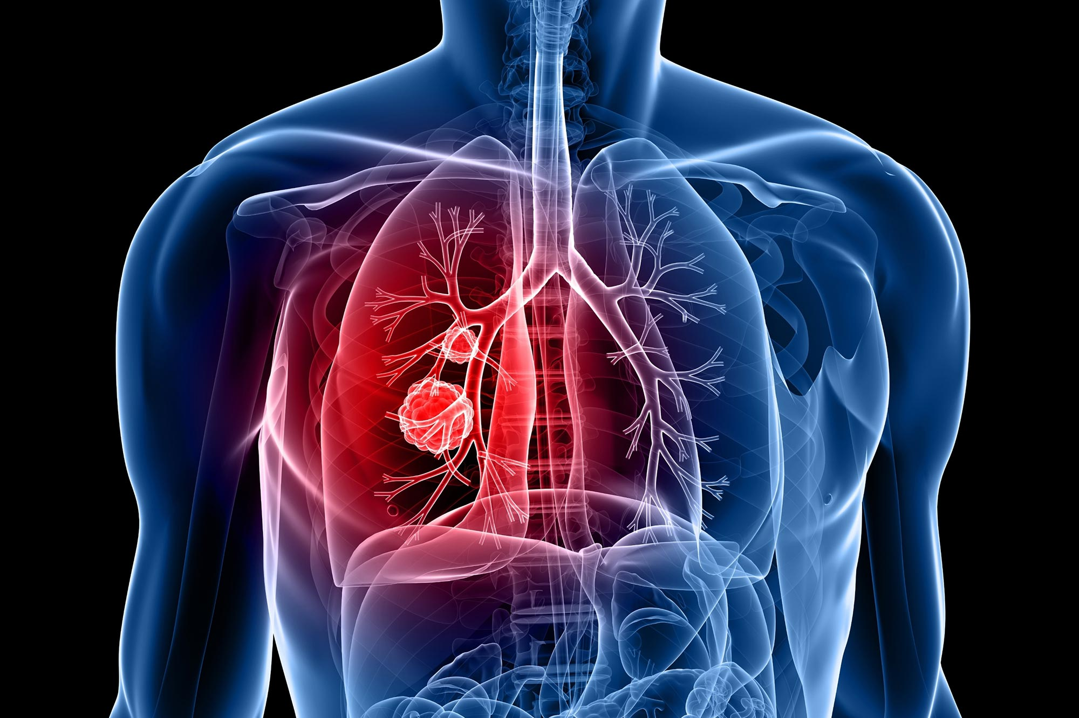
TARGET INDICATIONS INCLUDE 6 OF THE WORLD’S 12
DEADLIEST CANCERS
12 Deadliest Cancers World-Wide (Decoy Targets)
 |  |  | % of Yearly Deaths | % of Yearly Deaths |  |  |  | % of Yearly Cases | % of Yearly Cases
1 | Lung |  | 18.4 | 18.4 |  |  |  | 11.6 | 11.6
2 | Colorectal |  | 9.0 | 9.0 |  |  |  | 10.0 | 10.0
3 | Stomach |  | 8.2 | 8.2 |  |  |  | 5.7 | 5.7
4 | Liver |  | 8.2 | 8.2 |  |  |  | 4.7 | 4.7
5 | Breast |  | 6.6 | 6.6 |  |  |  | 11.6 | 11.6
6 | Esophagus |  | 5.3 | 5.3 |  |  |  | 3.2 | 3.2
7 | Pancreas |  | 4.5 | 4.5 |  |  |  | 2.5 | 2.5
8 | Prostate |  | 3.8 | 3.8 |  |  |  | 7.1 | 7.1
9 | Cervical |  | 3.3 | 3.3 |  |  |  | 3.2 | 3.2
10 | Leukemia |  | 3.2 | 3.2 |  |  |  | 2.4 | 2.4
11 | N-H Lymphoma |  | 2.6 | 2.6 |  |  |  | 2.8 | 2.8
12 | Bladder |  | 2.1 | 2.1 |  |  |  | 3.0 | 3.0
Decoy Indications % of Total |  |  | 29.7% | 29.7% |  |  |  | 26.2% | 26.2%
High Unmet Medical Need
3% - 17%
Percent five-year survival
for patients with metastatic disease
Source: American Cancer Society

Slide 24
EXPERIENCED MANAGEMENT TEAM
Leadership experience in new modalities and early development
Jeffrey Meckler - Chief Executive Officer
Jeffrey Meckler currently serves as our Chief Executive Officer, bringing more than 30 years of financial and healthcare leadership experience to the company. Most recently, Jeff was the CEO of Intec Pharma, and prior to that, CEO of Cocrystal Pharma, transforming it from a research company into a clinical and development company. He holds a B.S. in industrial management, an M.S. in industrial administration from the Tepper School of Business at Carnegie Mellon University, and a J.D. from Fordham University’s School of Law.
Michael J. Newman, Ph.D. - Founder and Chief Scientific Officer
A founder of the company, Dr. Michael Newman currently serves as our Chief Scientific Officer. Most recently, he was Founder and CEO of Decoy Biosystems, where he developed the technology that serves as the foundation of Indaptus. Michael received a Bachelor’s degree in biology from the University of California at San Diego, a Ph.D. in cell and developmental biology from Harvard Medical School (National Science Foundation Pre-doctoral Fellow) and carried out post-doctoral research at Cornell University.
Walt A. Linscott - Chief Business Officer
Walt Linscott brings three decades of global leadership, entrepreneurial and professional experience with broad business development, operational, regulatory, and transactional experience in the Life Sciences sector to his current role as Chief Business Officer at Indaptus. Most recently, he held a similar role at Intec Pharma. Walt holds a Master of Science in Experimental and Translational Therapeutics with honors from the University of Oxford, a Master’s degree in Global Business from the University of Oxford and Master’s degree in Entrepreneurship from Cambridge University. He earned his J.D. from the University of Dayton School of Law where he served as Managing Editor of the Law Review.
Boyan Litchev, MD - Chief Medical Officer
Boyan Litchev, MD brings to the company more than two decades of global experience in the pharmaceutical and biotechnology industry, with significant experience in the clinical development of in vivo gene therapy, CAR-T and NK cells, oligonucleotides (mRNA), peptides, small molecules, therapies for various diseases and indications. Dr. Litchev joins Indaptus Therapeutics from Shoreline Biosciences, where he was a Senior Vice President, Head of Clinical Development, NK cell therapy for Oncology. Dr. Litchev is a board-certified physician in Obstetrics and Gynecology. Dr. Litchev received his MD degree from Medical University Plovdiv. Prior to joining the pharmaceutical industry, he has treated patients and conducted clinical research in academic settings.
Nir Sassi - Chief Financial Officer
Nir Sassi currently serves as our Chief Financial Officer, bringing a broad skillset across management, corporate finance, due diligence, accounting, and financial analysis. Prior to joining Indaptus, Nir spent 11 years at Intec Pharma, starting as Vice President of Finance and ending his tenure there as Chief Financial Officer. He is a certified public accountant in Israel and holds a Bachelor’s degree in economics and accounting from Ben Gurion University in Beer Sheva, Israel.
24

Slide 25



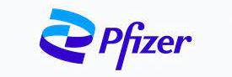



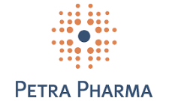











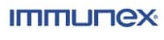


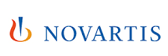




EXPERIENCED BOARD OF DIRECTORS
Leadership experience in new modalities and early development
Roger J. Pomerantz, M.D. - Chairman
Anthony J. Maddaluna - Director
W. Brad Hayes - Director
Brian O’Callaghan - Director
Hila Karah - Director
Mark Gilbert - Director
Michael Newman - Founder, CSO, Director
Jeffrey Meckler - CEO, Director
Decoy Biosystems
25

Slide 26

Investor & Media Relations:
CORE IR
Scott Birkby
sbirkby@coreir.com

