Slide 1

Investor Presentation
March 2022

Slide 2
Forward Looking Statements
This presentation contains forward‐looking statements with the meaning of the Private Securities Litigation Reform Act. These include statements regarding management’s expectations, beliefs and intentions regarding, among other things, our product development efforts, business, financial condition, results of operations, strategies, plans and prospects. Forward‐looking statements can be identified by the use of forward‐looking words such as “believe”, “expect”, “intend”, “plan“, “may“, “should“, “could“, “might“, “seek“, “target“, “will”, “project“, “forecast“, “continue” or “anticipate” or their negatives or variations of these words or other comparable words or by the fact that these statements do not relate strictly to historical matters. For example, forward‐looking statements are used in this presentation when we discuss Indaptus’s future plans and expected timeline of its development pipeline.
Forward‐looking statements relate to anticipated or expected events, activities, trends or results as of the date they are made. Because forward‐looking statements relate to matters that have not yet occurred, these statements are inherently subject to risks and uncertainties that could cause our actual results to differ materially from any future results expressed or implied by the forward-looking statements. In addition, historical results or conclusions from scientific research and clinical studies do not guarantee that future results would suggest similar conclusions or that historical results referred to herein would be interpreted similarly in light of additional research or otherwise. Many factors could cause actual activities or results to differ materially from the activities and results anticipated in forward‐looking statements, including, but not limited to, the following: Indaptus's plans to develop and potentially commercialize its technology; the timing and cost of Indaptus's planned investigational new drug application and any clinical trials; the completion and receiving favorable results in any clinical trials; Indaptus's ability to obtain and maintain regulatory approval of any product candidate; Indaptus's ability to protect and maintain its intellectual property and licensing arrangements; Indaptus's ability to develop, manufacture and commercialize its product candidates; the risk of product liability claims; the availability of reimbursement; the influence of extensive and costly government regulation; and Indaptus's estimates regarding future revenue, expenses, capital requirements and the need for additional financing following the merger. These risks, as well as other risks are discussed in the proxy statement/prospectus that was included in the registration statement on Form S-4 filed with the SEC in connection with the merger.
All forward‐looking statements speak only as of the date of this presentation and are expressly qualified in their entirety by the cautionary statements included in this presentation. Indaptus does not undertake any obligation to update or revise forward‐looking statements to reflect events or circumstances that arise after the date made or to reflect the occurrence of unanticipated events, except as required by applicable law.
The presentation contains information about investigation‐stage drug products under development, which have not yet been approved by the FDA for commercial distribution in the United States. All representations in this presentation are based upon investigations in certain clinical and other research, but which accordingly should not be construed as general claims for the safety or efficacy of the products when used by patients.
The presentation is not intended and does not constitute an offer to sell or the solicitation of an offer to buy any securities, nor shall there be any sale of securities in any jurisdiction in which such offer, solicitation or sale would be unlawful prior to the registration or qualification under the securities laws of any jurisdiction. No offering of securities shall be made except by means of a prospectus meeting the requirements of Section 10 of the Securities Act of 1933, as amended.

Slide 3
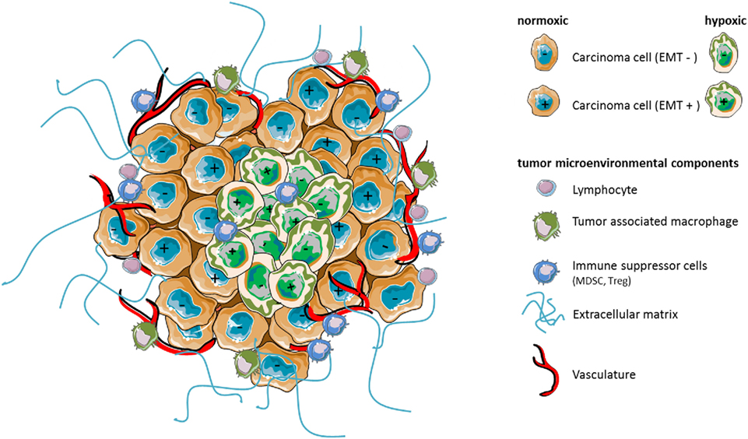







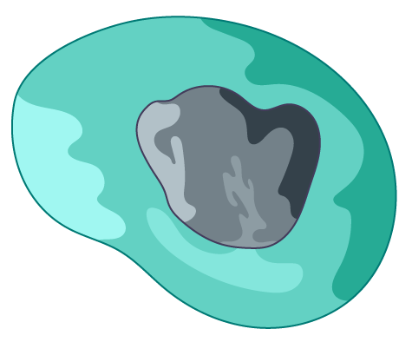
Current Cancer Immunotherapies:
Low Percentage Cures for Most Advanced Cancers
Current approaches activate only one or a few innate or adaptive immune cell types
Gamma-Delta
T-Cell
TAA
Natural Killer
T-Cell
Tumor
Tumor
Natural Killer Cell
Dendritic Cell
Innate
Neutrophil
CD8+ T-Cell
Adaptive
TAA
Macrophage
CD4+ T-Cell
Targeted Antibodies
IL-2 and IFN-α
T-vec/GM-CSF
Checkpoint
CAR-T

Slide 4
Decoy Technology: Improving Cancer Immunotherapy
Shifting approach from continuous single target activation to brief priming of full innate and adaptive cellular pathways
Assumption
Decoy Technology
We believe we need innate & adaptive pathway activation in lymphoid organs as well as tumor
  Tumors promote an immune-suppressive environment
  Tumors negatively remodel the entire systemic immune system
  Most steps required for innate and adaptive immune responses take place outside of the tumor
Multi-targeted package of i.v. safe immune system activating signals
  Bacteria-based platform
    Multiple Toll-Like Receptors (TLR) Agonists
    NOD-Like Receptors (NLR) Agonists
  TLRs directly and indirectly activate essentially all immune cells (innate + adaptive)
  There is clinical precedent in oncology
  Indaptus pre-clinical data demonstrates potential for safe, systemic administration
4

Slide 5
Goal is Activation of Both Innate and Adaptive Cellular Pathways in Multiple Locations Safely
Decoy Technology’s multi-targeted approach
Gamma-Delta
T-Cell
TAA
Natural Killer
T-Cell
Innate
Adaptive
Natural Killer Cell
Dendritic Cell
Neutrophil
CD8+ T-Cell
TAA
Macrophage
CD4+ T-Cell
Tumor
5

Slide 6
Indaptus has Developed a Novel Approach
Decoy Product
Result and Predictions
        Start with a single, pure strain of
        non-pathogenic, Gram-negative bacteria
        Reduce lipopolysaccharide levels by ~90%
        Process therapeutic (e.g. kill the bacteria, stabilize the structure, etc.) for infusion administration
        Product is a frozen suspension
        Chemical modification yields NCE
        Broad patent coverage: CoM + Methods
        4 issued US & 27 issued foreign patents
        Additional world-wide applications
        Nominal expiry – 2 families 2033/2039
Decoy therapeutic is significantly less toxic in vivo than untreated bacteria and several live competitor products
i.v. bacteria are passively targeted to liver, spleen and tumors, and cleared rapidly
Predict “Goldilocks” effect:
  Immune activation better than with i.t. dosing:
  Critical activation in spleen and can target primary liver cancer and liver metastasis from other tumors
  Passive targeting and rapid clearance precludes continuous, systemic exposure common to small molecule, antibody and CAR therapies:
  Reduced chance of systemic toxicity

Slide 7
Indaptus Pre Clinical Data – Effective, Safe and Patented
        Decoy therapeutics exhibit many unique properties
  Single agent anti-tumor activity + tumor eradicating synergy with 5 different existing therapies
  Reduced toxicity and broad therapeutic index (no increase in toxicity with combinations)
  Safe induction of both innate and adaptive immune pathways (MoA) confirmed
  Innate and adaptive immunological memory leading to rejection of tumor re-challenge
  Efficacy in mouse syngeneic and human tumor xenograft models (CRC, HCC, Pancreatic, NHL)
  GMP batch of drug product produced (Decoy20) – stable for ≥6 months at -70°C, -20°C and 5°C
  IND-enabling toxicology with GMP drug product – no induction of cytokine release syndrome
  Significant single agent activity in pre-clinical models of HBV and HIV

Slide 8
Decoy Treatment Does Not Impair Anti-Tumor Cytokine/Chemokine Induction
Despite being less toxic, Decoy therapeutics induce similar amounts of anti-tumor cytokines and chemokines,
uncoupling toxicity from anti-tumor activity
Decoy therapeutics are more broadly active
than mono-specific TLR agonists
Secretion by Human PBMCs* In Vitro | Untreated Bacteria | Decoy Therapeutic (Decoy10) | Decoy Therapeutic (Decoy20)
Anti-Tumor Cytokine | pg/mL (mean of triplicate determinations ± %CV at same bacterial dose for each cytokine
GM-CSF | 1,094 ± 22 | 1,197 ± 2 | 1,695 ± 23
IFNγ | 175,866 ± 7 | 47,488 ± 3 | 55,321 ± 10
IL-12p70 | 176 ± 14 | 528 ± 7 | 428 ± 37
TNFα | 49,782 ± 11 | 77,919 ± 13 | 99,247 ± 16
Secretion by Human PBMCs In Vitro | CpG (TLR9) | Poly(I:C) (TLR3) | R848 (TLR7/8) | LPS (TLR4) | Decoy10* (TLR2,4,5,9)
Anti-Tumor Cytokine | pg/mL (triplicate full titration peak average from two exp)
GM-CSF | 0 | 2 | 136 | 27 | 1,246
IFNγ | 7 | 248 | 61,914 | 33,293 | 171,284
IL-12p70 | 4 | 15 | 205 | 84 | 375
TNFα | 65 | 334 | 36,663 | 24,944 | 73,069
MIP-1α** | 0 | 272 | 17,866 | 19,278 | 29,942
*Peripheral Blood Mononuclear Cells
*Decoy therapy tested at doses therapeutically relevant for in vivo models
**From one experiment

Slide 9
Single Agent Activity - Metastatic Mouse Pancreatic Carcinoma
 | No Treatment | Decoy 5x10^7 | Gem | Decoy 2x10^8
Median Survival | 27 Days | 35 Days P<0.01 | 41 Days P<0.01 | 75 Days P<0.01
Log-Rank Test
Decoy20 vs. No Treatment
Both Doses P ≤ 0.0008
Decoy i.v. 2x per week x 3
Percent Survival
Decoy20 2x10^8
Decoy 2x10^8
No Treatment
Pancreatic tumor cells were
injected into the spleen on Day 0
All untreated mice develop large
tumors in spleen, pancreas and liver
Gemcitabine
2x/week x 7
Decoy 5x10^7
Decoy20 5x10^7
Days Post Tumor Cell Inoculation
(Treatment started on Day 5 with 7 mice/group)

Slide 10
Single Agent Activity - Orthotopic Mouse Colorectal Carcinoma
Tumor fragments were sewn onto the cecum wall on Day 0 (7 mice/group)
Dose and regimen not optimized
Decoy 2x10^8 (i.v. 2x per week x 3)
Metastasis
11 total in 5 sacrificed mice
0 in mouse sacrificed on Day 118
Decoy Vehicle
Metastasis
>41 total in 6 sacrificed mice
Log-rank P = 0.0004
Also, combination-based eradications with s.c. tumors

Slide 11
Decoy Synergizes With a Non-Steroidal Anti-Inflammatory Drug (NSAID)
to Safely Eradicate Subcutaneous Mouse Hepatocellular Carcinomas (HCC)
Treat 6 mice per group with Decoy 2x per week i.v. for 7 weeks / Start treatment at 103 mm³
Decoy
Vehicle
Decoy
2x10^8 2x/wk
NSAIDS reduce
myeloid-derived
immune suppressive cells
Toxicity = transient 2-day weight
loss during first 3 weeks of treatment
Max % below
Decoy +
NSAID
NSAID (Indomethacin)
low dose in drinking water
3/6 CR
9 8 7 2 1 0 0

Slide 12
Combination With Anti-PD-1 Checkpoint Therapy Produces
100% Complete Responses With Hepatocellular Carcinoma
All animals also received NSAID
Mean Tumor Volume (mm³ ± SEM)
Twice per week
Decoy produced
3-4/6 full regressions
*
* Max % transient weight loss each week for combo treatment No increase in toxicity with triple combo
Days After Tumor Cell Implant

Slide 13
Synergistic Eradication of Murine HCC
Exhibits a Very Wide Decoy Therapeutic Index (≥33-fold)
All animals also received a non-steroidal anti-inflammatory drug (NSAID)

Slide 14
Mice Cured by Decoy + NSAID + Anti-PD-1 and Re-Challenged with Fresh HCC Tumor Cells Reject the Tumors (Immunological Memory)
Eleven Cured Mice were Re-Challenged with Fresh HCC Tumor Cells on Day 91 on the Opposite Flank from the First Challenge
Six Naïve Mice were Challenged
with the Same Tumor Cells as the Cured Mice on the Same Day
Cured Mice*
Naïve Mice
*All 1st challenge tumor sites remained tumor-free

Slide 15

Decoy Produces Similar Results in Multiple Mouse Models
Decoy Therapeutic Synergizes with Low-Dose Chemotherapy (LDC) to Safely Induce Regression of s.c. Mouse Non-Hodgkin’s-Lymphoma (NHL)
Mice Cured by Decoy + LDC and Re-Challenged with Fresh NHL
Tumor Cells Reject the Tumors (Immunological Memory)
Tumor Cell Re-Challenged on Opposite Flank on 8 Cured Mice on day 77
Tumor Cell-Match Challenge
on 5 Naive Mice on day 77
Decoy
Small 33-145 mm³ tumors
appeared on 6/8 mice between days 7 to 18
All tumors rejected
Experiment done twice*
Control
LDC/no regressions
Mean Tumor Volume (mm3m ± )
LDC may reduce Treg
immune suppressive cells
Tumor Volume (mm³)
Treat with Decoy + LDC for 2 weeks starting day 13 (8/8 mice cured) Rechallenged with tumor cells on opposite flank on day 77 (above left)
Decoy + LDC 6/6 full regressions
Days After Tumor Cell Implant
Days After 1st Tumor Cell Implant
*Immunological memory also seen with innate-only human tumor xenograft model

Slide 16
Decoy Technology Also Regresses Human Tumor Xenografts
Treat 5 mice per group 2x per week for 3 weeks / Start treatment at 173 mm³
Rituximab 2x per week i.p. x 3
NHL standard of care
Control
LDC
Decoy (2x10^8)
Control
Decoy
Decoy + LDC
Rituximab (100 µg)
Decoy + LDC +
Rituximab
LDC
Decoy + LDC
Decoy + LDC + Rituximab 5/5 full regressions*
⬥
⬥
⬥
*4/5 tumors regrew at later time-points
Repeat produced 2/4 durable regressions
16

Slide 17
Decoy Technology can Induce Immunological Memory Via the Innate Immune System
5 tumor-regressed mice from last slide
each injected s.c. on opposite flank with
fresh tumor cells (3/5 with no new tumor)
5 naïve mice each
injected s.c. with
same tumor cells
Tumor regression with immunological memory via the innate immune system alone is very rare in preclinical models, but consistent with a multiple danger signal mechanism
Results suggest that Decoy technology may synergize with other marketed ADCC mechanism-based, targeted antibody therapeutics (~12 on market)
17

Slide 18
Decoy Technology Platform
Potential utility as anti-viral therapy - Hepatitis B Virus (HBV), HIV and Others
HBV is a chronic liver infection affecting 257 million people world-wide
  Only 2% treated with current therapies / Major cause of cirrhosis and HCC / 887,000 deaths per year
Cytokines have strong anti-viral activity, but single, oral TLR agonists have failed in the clinic
Multi-TLR agonist Decoy therapy is passively targeted to liver and safely induce cytokines
Standard pre-clinical AAV-HBV mouse model of chronic HBV carried out twice:

Slide 19
Indaptus Clinical Development Plan
 | 2021 2022 |  | 2022 2023 |  | 2023 2024 |  | 2024 2025 |  | 2025 2026
 | Q3/4 | Q1/2 | Q3/4 | Q1/2 | Q3/4 | Q1/2 | Q3/4 | Q1/2 | Q3/4 | Q1/2
Dose Escalation Single Ascending Doses
Expansion Multiple Doses All Comers Then Focus
Ph1b Combination Checkpoint / Targeted Abs / Chemo?

Slide 20
Target Indications Include 6 of the World’s 12 Deadliest Cancers
12 Deadliest Cancers World-Wide (Decoy Targets)
 |  |  | % of Yearly Deaths | % of Yearly Deaths |  |  |  | % of Yearly Cases | % of Yearly Cases
1 | Lung |  | 18.4 | 18.4 |  |  |  | 11.6 | 11.6
2 | Colorectal |  | 9.0 | 9.0 |  |  |  | 10.0 | 10.0
3 | Stomach |  | 8.2 | 8.2 |  |  |  | 5.7 | 5.7
4 | Liver |  | 8.2 | 8.2 |  |  |  | 4.7 | 4.7
5 | Breast |  | 6.6 | 6.6 |  |  |  | 11.6 | 11.6
6 | Esophagus |  | 5.3 | 5.3 |  |  |  | 3.2 | 3.2
7 | Pancreas |  | 4.5 | 4.5 |  |  |  | 2.5 | 2.5
8 | Prostate |  | 3.8 | 3.8 |  |  |  | 7.1 | 7.1
9 | Cervical |  | 3.3 | 3.3 |  |  |  | 3.2 | 3.2
10 | Leukemia |  | 3.2 | 3.2 |  |  |  | 2.4 | 2.4
11 | N-H Lymphoma |  | 2.6 | 2.6 |  |  |  | 2.8 | 2.8
12 | Bladder |  | 2.1 | 2.1 |  |  |  | 3.0 | 3.0
Decoy Indications % of Total |  |  | 29.7% | 29.7% |  |  |  | 26.2% | 26.2%
High Unmet Medical Need
Percent five-year survival
for patients with metastatic disease
3% - 17%
Source: American Cancer Society
Source: CA CANCER J CLIN 2018;68:394-424

Slide 21










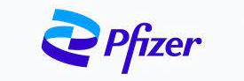





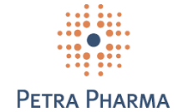









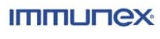
Board of Directors
        Leadership experience in new modalities and early development
Roger J. Pomerantz, M.D. | Chairman
Michael J. Newman, Ph.D. | Founder, CSO, Director
Jeffrey Meckler | CEO, Director
Anthony J. Maddaluna | Director
W. Brad Hayes | Director
Brian O’Callaghan | Director
Hila Karah | Director
Mark Gilbert | Director
Decoy Biosystems

Slide 22




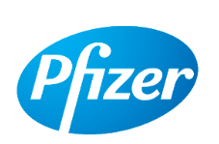
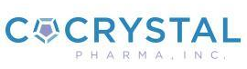










Experienced Management Team
Decoy Biosystems
Jeffrey Meckler
Michael J. Newman, Ph.D.
Chief Executive Officer
Founder and Chief Scientific Officer
Nir Sassi
Walt A. Linscott
Boyan Litchev, M.D.
Chief Financial Officer
Chief Business Officer
Chief Medical Officer

Slide 23
Indaptus Therapeutics
With the ability to harness both the body’s innate and adaptive immune responses, we believe we are uniquely positioned to revolutionize the treatment of cancer and certain infectious diseases.
✓
Broad Platform
Immunology-based anti-tumor & anti-viral platform with a wide therapeutic index
Oncology, HBV, HIV activity
✓
Safety
Attenuation and passive targeting reduces systemic exposure and toxicity
IND-enabling toxicology indicates no induction of cytokine release syndrome
✓
Efficacy
Synergistic with checkpoint therapy, targeted antibodies or chemotherapy
80 to 100% complete responses in multiple mouse and human tumor models
✓
CMC
Tech transfer & scale up processes completed - GMP material manufactured
Clinical product released and stable for ≥6 months under multiple conditions
✓
IP
Composition of matter (NCE), methods of making and methods of using patents granted
Patent estate runs though 2039
✓
Inflection Timeline
US FDA Pre-IND meeting completed / IND filing anticipated 1H 2022
Phase 1 initiation anticipated 2022

Slide 24
Thank you.

